Slide 1
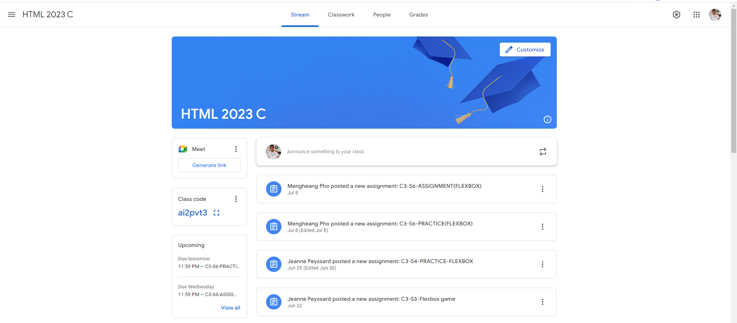
Identify root components of website below

Slide 2
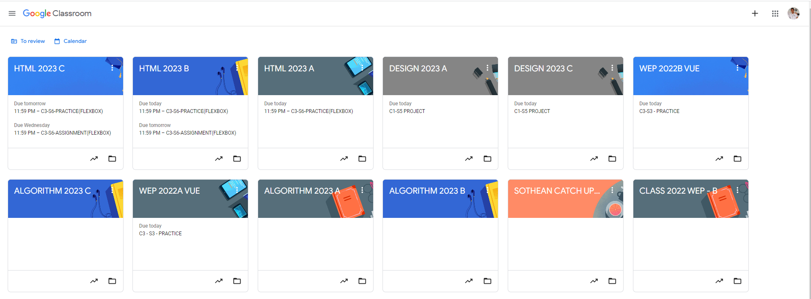
Root div
- Height: 100vh
content
nav
Flex: 0
header
Flex: 0
Flex: 1

Slide 3
Main-content
nav
Flex: 0
header
Flex: 0
Flex: 1
Flex:0
Flex: 1
Left img
Flex:1
main -sidebar
Main-content
Right-content
content
Flex: 0
Flex: 1
Flex-direction:row
content
Left img
Flex:1
Right-content
Flex-direction:column
content
Left img
Flex:1
Right-content
content
Left img
Flex:1
Right-content
Flex-direction:column
Flex-direction:row

